Slide 1
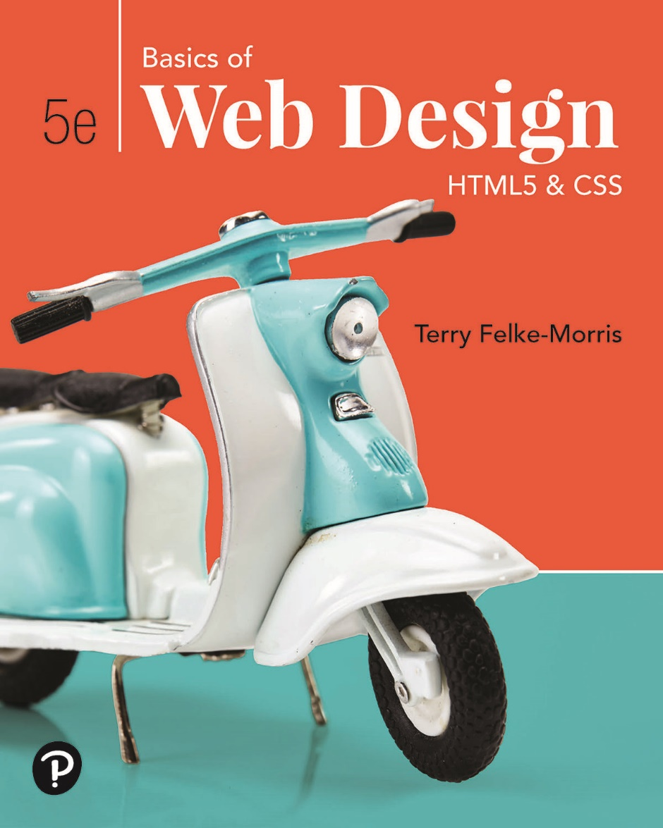
Basics of Web Design
Fifth Edition
Chapter 11
Media and Interactivity Basics Key Concepts
Slide in this Presentation Contain Hyperlinks. JAWS users should be able to get a list of links by using INSERT+F7
Copyright © 2019 Pearson Education, Inc. All Rights Reserved
Notes:
If this PowerPoint presentation contains mathematical equations, you may need to check that your computer has the following installed:
1) Math Type Plugin
2) Math Player (free versions available)
3) NVDA Reader (free versions available)

Slide 2
Learning Outcomes
Describe types of multimedia files used on the Web
Configure hyperlinks to multimedia files
Configure audio and video on a web page with H T M L 5 elements
Configure a Flash animation on a web page
Describe features and common uses of JavaScript and jQuery
Use the C S S transform and transition properties
Create an interactive image gallery with C S S
Configure a drop-down interactive menu with C S S
Configure an interactive widget with the H T M L 5 details and summary elements
Describe the purpose of geolocation, web storage, offline web applications, and canvas H T M L 5 A P I s

Slide 3
Helper Applications & Plug-ins
Helper Application
A program that can be designated to handle a particular file type (such as .wav or.mpg) to allow the user to view or otherwise utilize the special file.
The helper application runs in a separate window from the browser.
Plug-In
A newer and more common method
Plug-ins run right in the browser window so that media objects can be integrated directly into the web page.

Slide 4
Containers & Codecs
Container
Designated by the file extension – contains the media and metadata
Codec
The algorithm used to compress the media
H T M L 5 audio & video
Native to the browser
Browsers do not support the same codecs http://www.jwplayer.com/html5/

Slide 5
Commonly Used Plug-ins
Adobe Flash Player
Adobe Reader
Apple Quicktime

Slide 6
Common Audio File Types
.wav Wave File
.aiff Audio Interchange File Format
.mid Musical Instrument Digital Interface (M I D I)
.au Sun U N I X sound file
.mp3 M P E G-1 Audio Layer-3
.ogg Ogg Vorbis (open-source)
. m4a M P E G 4 Audio.
This audio-only M P E G-4 format is supported by Quicktime, iTunes, and iPods.

Slide 7
Common Video File Types
.mov Quicktime
.avi Microsoft Audio Video Interleaved
.wmv Windows Media File
.flv Flash Video File
.mpg M P E G (Motion Picture Experts Group)
.m4v .mp4 (M P E G-4)
.ogv Ogg Theora (open-source)
.webm V P8 codec (open video format, free)

Slide 8
Copyright Issues
Only publish web pages, images, and other media that you have personally created or have obtained the rights or license to use.
Ask permission to use media created by another person instead of simply “grabbing” it.
All work (including web pages) are automatically copyrighted even if there is not copyright mark or date.
Fair Use Clause of the Copyright Act
Creative Commons – A new approach to copyright https://creativecommons.org/

Slide 9
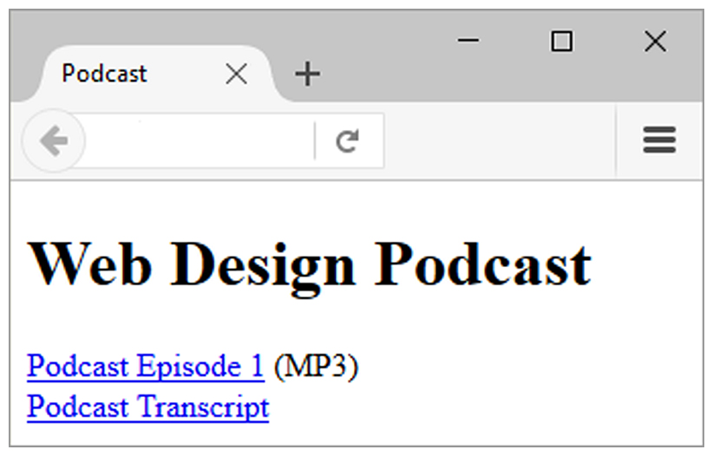
Configure Audio & Video
The most basic method to provide audio or video files:
Hyperlink
<a href="wdfpodcast.mp3" title="Web Design Podcast">Web Design Podcast</a>

Slide 10
Multimedia & Accessibility
Provide alternate content
Transcript (for audio)
Captions (for video)
Text format

Slide 11
What is Adobe Flash?
A popular multimedia application
Create multimedia which adds visual interest and interactivity to web pages
Flash movies are saved in “.swf” files
Perception of speedy display
.swf files play as they download
Flash Player
Free browser plug-in
Widely installed on browsers

Slide 12
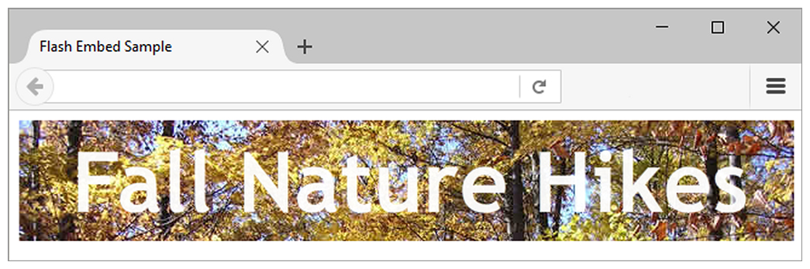
H T M L 5 Embed Element
<embed type="application/x-shockwave-flash" src="fall5.swf"
width="640"
height="100"
quality="high”
title="Fall Nature Hikes">

Slide 13
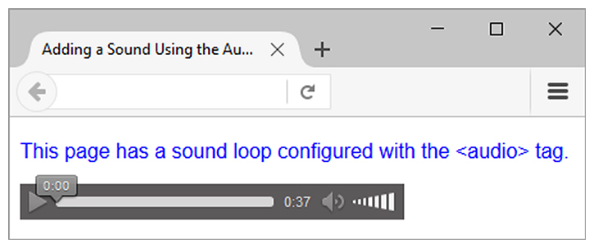
H T M L 5 Audio & Source Elements
<audio controls="controls">
<source src="soundloop.mp3" type="audio/mpeg">
<source src="soundloop.ogg" type="audio/ogg">
<a href="soundloop.mp3">Download the Audio File</a> (M P 3)
</audio>

Slide 14
H T M L 5 Audio & Source Elements
The HTML <audio> element is used to play an audio file on a web page.
The controls attribute adds audio controls, like play, pause, and volume.
The <source> element allows you to specify alternative audio files which the browser may choose from. The browser will use the first recognized format.

Slide 15
H T M L 5 Audio & Source Elements
The text between the <audio> and </audio> tags will only be displayed in browsers that do not support the <audio> element.
To start an audio file automatically, use the autoplay attribute of <audio> element.
Add muted attribute after autoplay to let your audio file start playing automatically (but muted).

Slide 16
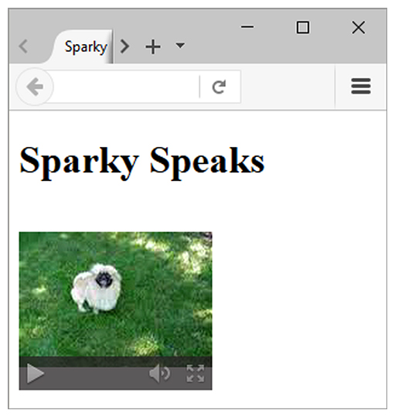
H T M L 5 Video & Source Elements
<video controls="controls" poster="sparky.jpg"
width="160" height="150">
<source src="sparky.m4v" type="video/mp4">
<source src="sparky.ogv" type="video/ogg">
<a href="sparky.mov">Sparky the Dog</a> (.mov)
</video>

Slide 17
H T M L 5 Video & Source Elements
The HTML <video> element is used to show a video on a web page.
The controls attribute adds video controls, like play, pause, and volume.
It is a good idea to always include width and height attributes. If height and width are not set, the page might flicker while the video loads.
The <source> element allows you to specify alternative video files which the browser may choose from. The browser will use the first recognized format.

Slide 18
H T M L 5 Video & Source Elements
The text between the <video> and </video> tags will only be displayed in browsers that do not support the <video> element.
To start a video automatically, use the autoplay attribute.
Add muted attribute after autoplay to let your video start playing automatically (but muted).

Slide 19
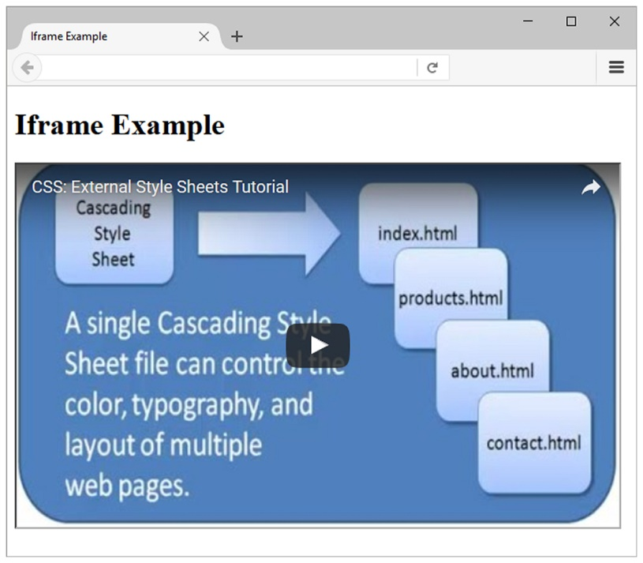
Use the iframe element to embed YouTube Video
<iframe src="http://www.youtube.com/embed/VIDEO_ID" width="640" height="385"> View the <a href="http://www.youtube.com/watch?v=VIDEO_ID">YouTube Video</a> </iframe>

Slide 20
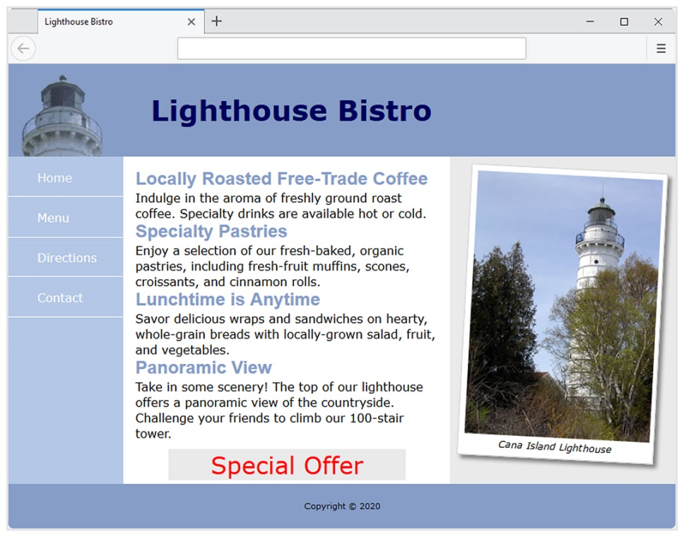
C S S 3 Transform Property
Allows you to rotate, scale, skew, or move an element
Examples:
Rotate 3 degrees: transform: rotate(3deg);
Display twice as large: transform: scale(2);

Slide 21
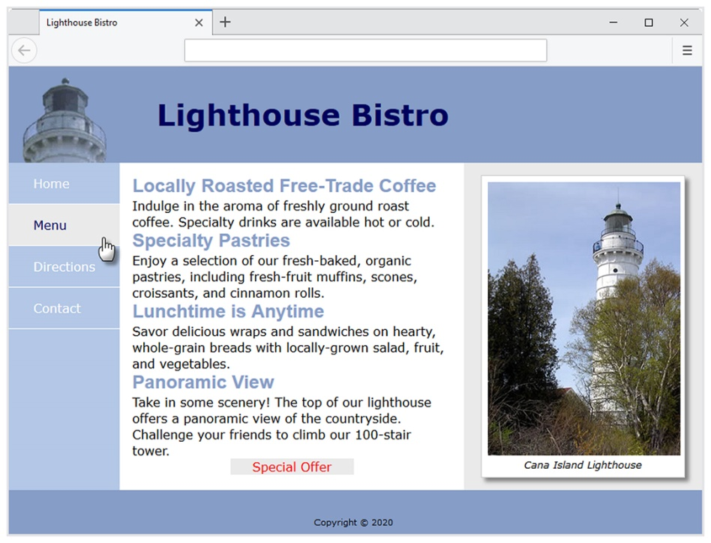
C S S 3 Transition Property
Provides for changes in property values to display in a smoother manner over a specified time.
Example:
nav a:hover { color: #8 6 9 d c 7; background-color: #e a e a e a; transition: background-color 2s linear; }

Slide 22
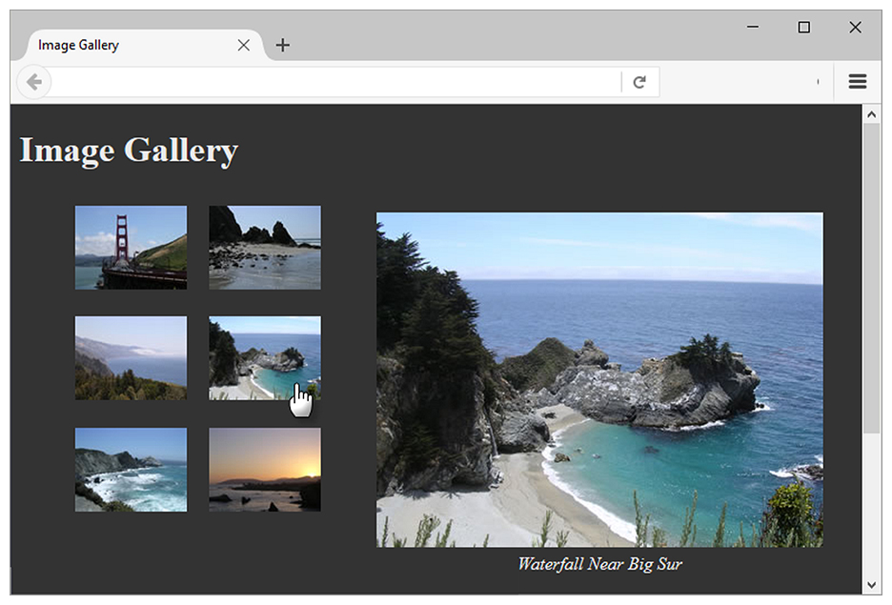
C S S Image Gallery
Configure each thumbnail image:
<li><a href="photo1.jpg"><img src=“thumb1.jpg" width="100" height="75" alt="Golden Gate Bridge">
<span><img src="photo1.jpg" width="400" height="300“ alt="Golden Gate Bridge"><br>Golden Gate Bridge </span></a>
</li>
The key C S S:
#gallery span { position: absolute;
left: -1000px; }
#gallery a:hover span { position: absolute;
top: 16px; left: 320px;
text-align: center; }

Slide 23
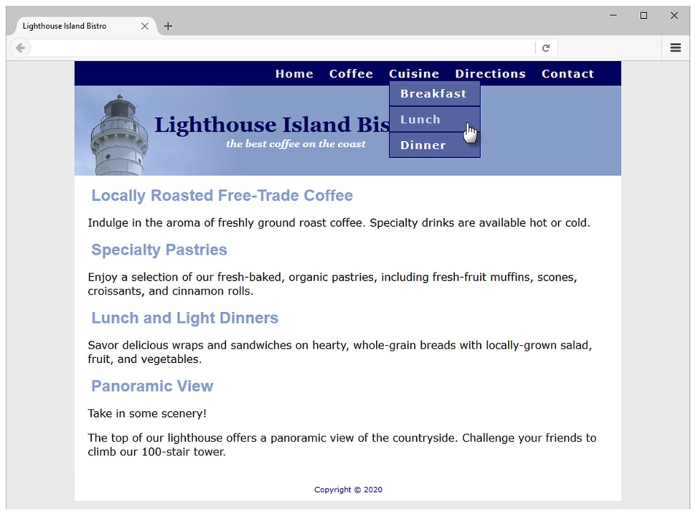
C S S Drop Down Menu
Configure nav container with position relative
Code submenu (drop down menu) ul element with the parent li element
Configure submenu ul element to initially not display
Configure submenu ul element with absolute positioning

Slide 24
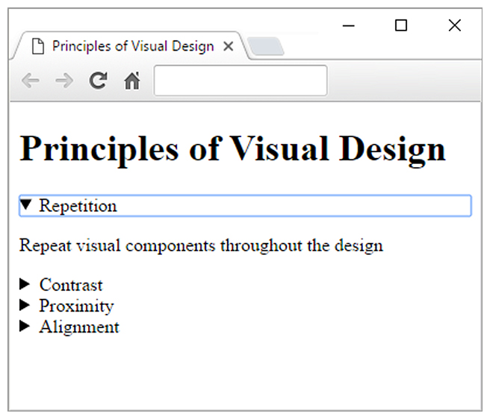
H T M L 5 Details & Summary Elements
Configure an interactive widget
As of 2018, still not supported by all modern browsers
Check http://caniuse.com/#feat=details
<details>
<summary>Repetition</summary>
<p>Repeat visual components throughout the design</p>
</details>
<details>
<summary>Contrast</summary>
<p>Add visual excitement and draw attention</p>
</details>
<details>
<summary>Proximity</summary>
<p>Group related items</p>
</details>
<details>
<summary>Alignment</summary>
<p>Align elements to create visual unity</p>
</details>

Slide 25
What is JavaScript?
Object-based scripting language
Manipulates the objects associated with a Web page document:
the window
the document
the elements such as forms, images, hyperlinks, and so on

Slide 26
Common Uses of JavaScript
Display a message box
Select list navigation
Edit and validate form information
Create a new window with a specified size and screen position
Image Rollovers
Status Messages
Display Current Date
Calculations

Slide 27
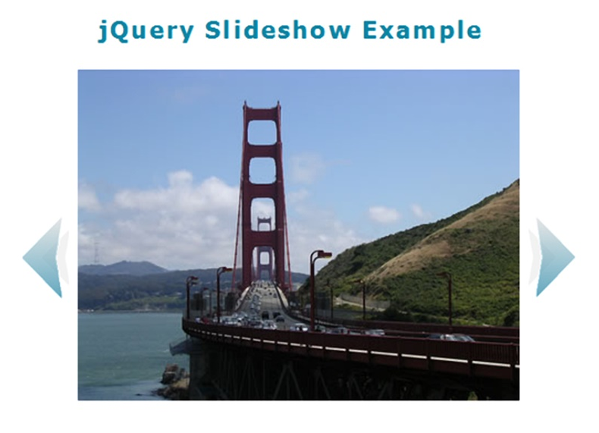
Exploring JQuery
A JavaScript library intended to simplify client-side scripting
Example: http://webdevfoundations.net/jquery
A P I – Application Programming Interface
A protocol that allows software components to communicate – interacting and sharing data.
The jQuery A P I can be used to configure many interactive features, including:
image slideshows
animation (moving, hiding, fading)
event handling (mouse movements and mouse clicking)
document manipulation
Ajax

Slide 28
H T M L 5 A P I s
A P I – a protocol that allows software components to communicate – interacting and sharing data
A variety of A P Is that are intended to work with H T M L 5, C S S, and JavaScript are currently under development and in the W 3 C approval process, including:
geolocation
web storage
service workers
canvas

Slide 29
H T M L 5 Geolocation
Allows your web page visitors to share their geographic location
Their location may be determined by the I P address, wireless network connection, local cell tower, or G P S hardware depending on the type of device and browser.
JavaScript is used to work with the latitude and longitude coordinates provided by the browser.
Example:
http://html5demos.com/geo

Slide 30
H T M L 5 Web Storage
Traditionally, the JavaScript cookie object has been used to store information in key-value pairs on the client (the website visitor’s computer).
NEW FOR H T M L 5: Web Storage A P I
provides two new ways to store information on the client side: local storage and session storage.
Advantage: increase in the amount of data that can be stored (5M B per domain).
The localStorage object stores data without an expiration date.
The sessionStorage object stores data only for the duration of the current browser
JavaScript is used to work with the values stored in the localStorage and sessionStorage objects.
Examples:
http://webdevfoundations.net/storage and http://html5demos.com/storage

Slide 31
H T M L 5 P W A
Progressive Web Application
Offers a rich experience similar to a native app on a mobile device—the user can choose to add the website's icon to the home screen, and the website has some level of functionality even when the device is not connected to the Internet.
Manifest A P I
Contains information about the P W A; including the data needed for the P W A's icon to be added to the home screen of a
Service Workers A P I
Provides a way for websites to perform persistent background processing such as push notifications and background data syncing.
Service worker: JavaScript that runs in the background, separate from a web page, and listens for events such as install, activate, message, fetch, sync, and push.
Requires H T T P S

Slide 32
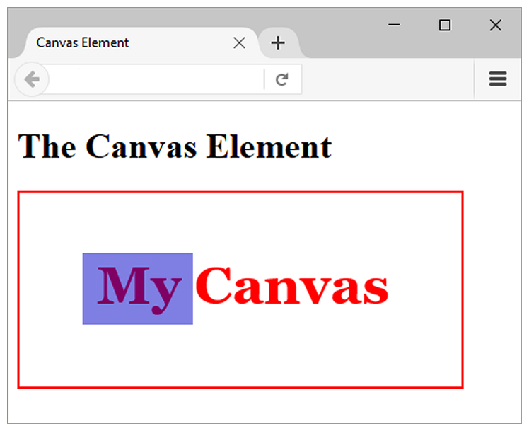
H T M L 5 Canvas Element
Configures dynamic graphics
Draw lines, shapes, text, image
Interact with actions taken by the user
Canvas A P I (application programming interface)
JavaScript – client-side scripting language
<script type="text/javascript">
function drawMe() {
var canvas = document.getElementById("myCanvas");
if (canvas.getContext) {
var ctx = canvas.getContext("2d");
ctx.fillStyle = "rgb(255, 0, 0)";
ctx.font = "bold 3em Georgia";
ctx.fillText("My Canvas", 70, 100); ctx.fillStyle = "rgba(0, 0, 200, 0.50)";
ctx.fillRect (57, 54, 100, 65);
}
}
</script>

Slide 33
Summary
This chapter introduced the H T M L and C S S techniques and technologies used to configure sound, video, and interactivity on web pages.
Issues related to accessibility and copyright were also discussed.
The number one reason for visitors to leave web pages is too long of a download time. When using multimedia, be careful to minimize this issue.

Slide 34

Copyright
This work is protected by United States copyright laws and is provided solely for the use of instructors in teaching their courses and assessing student learning. Dissemination or sale of any part of this work (including on the World Wide Web) will destroy the integrity of the work and is not permitted. The work and materials from it should never be made available to students except by instructors using the accompanying text in their classes. All recipients of this work are expected to abide by these restrictions and to honor the intended pedagogical purposes and the needs of other instructors who rely on these materials.

